Slide 1
Lecture 3 Cloud Computing Architecture & Management
Dr. Mohamed ElAraby

Slide 2
Objectives
Provide an overview of the cloud architecture.
Give an insight on the anatomy of the cloud.
Describe the role of network connectivity in the cloud.
Give a description about applications in the cloud.
Give a detailed description about managing the cloud.
Provide an overview about application migration to the cloud.

Slide 3
Introduction
Architecture is the hierarchical view of describing a technology.
Includes the components over which the existing technology is built and the components that are dependent on the technology.
Another topic that is related to architecture is anatomy.
Anatomy describes the core structure of the cloud.
The cloud is a completely Internet-dependent technology.

Slide 4
Introduction
Cloud management discusses the important management issues and ways in which the current cloud scenario is managed.
The way an application and infrastructure in the cloud are managed.
Management is important due to the quality of service (QoS) factors that are involved in the cloud.
These QoS factors form the basis for cloud computing.

Slide 5
Introduction
Application migration to the cloud also plays a very important role.
Not all applications can be directly deployed to the cloud.
An application needs to be properly migrated to the cloud to be considered a proper cloud application that will have all the properties of the cloud.

Slide 6
Cloud Architecture
Cloud architecture describes its working mechanism.
Cloud is completely dependent on Internet for its functioning.
The cloud architecture can be divided into four layers based on the access of the cloud by the user:
Layer 1 (User/Client Layer)
Layer 2 (Network Layer)
Layer 3 (Cloud Management Layer)
Layer 4 (Hardware Resource Layer)

Slide 7
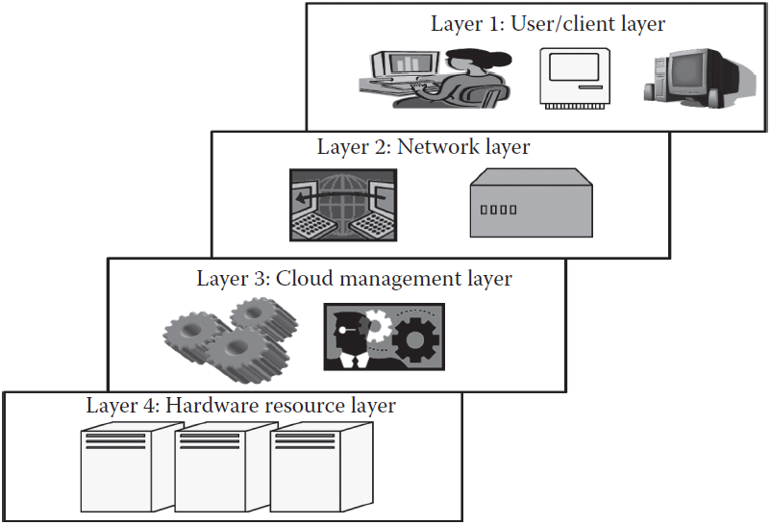
Cloud Architecture

Slide 8
Anatomy of the Cloud
Cloud anatomy defined as the structure of the cloud.
Cloud anatomy cannot be considered as cloud arch.
May not include any dependency on which or over which the technology works,
Whereas architecture wholly defines and describes the technology over which it is working.
Architecture is a hierarchical structural view that defines the technology as well as the technology over which it is dependent or/and the technology that are dependent on it.
Anatomy can be considered as a part of architecture.

Slide 9
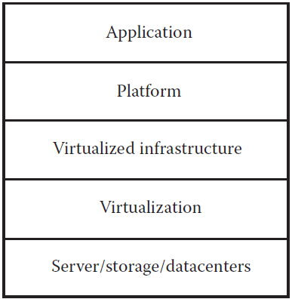
Cloud Structure

Slide 10
Network Connectivity
Public Cloud Access Networking
Private Cloud Access Networking
Intracloud Networking for Public Cloud Services
Private Intracloud Networking
New Facets in Private Networks
Path for Internet Traffic

Slide 11
Applications on Cloud
A stand-alone application
Developed to be run on a single system without network
Use only the machine in which they are installed
Totally dependent on resources or features within system
self-sustaining, no data/processing power of other systems
Web application
Client server architecture, Totally dependent on the network for its working.
Cloud application
Elastic, multitenant, quantitative measurement, multi-platforms, handle peak load transactions.

Slide 12
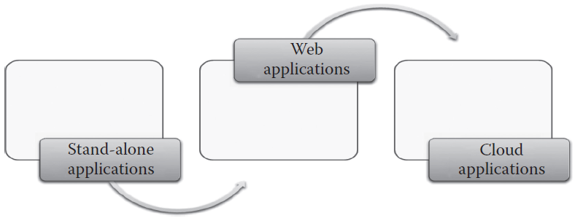
Cloud application

Slide 13
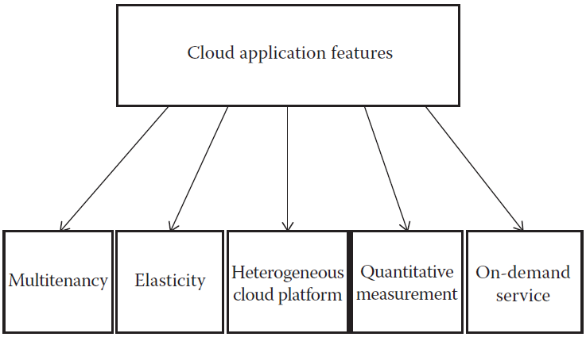
Cloud application features

Slide 14
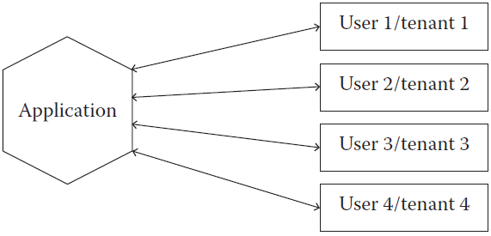
Cloud application features: Multitenancy

Slide 15
Managing the Cloud
Managing the infrastructure of the cloud
Managing the cloud application

Slide 16
Migrating Application to Cloud
Cloud migration: moving one or more enterprise applications and their IT environments from the traditional hosting type to the cloud environment, either public, private, or hybrid.
Phases of Cloud Migration:
Evaluation
Migration strategy
Prototyping
Provisioning
Testing

Slide 17
Migrating Application to Cloud
Approaches for Cloud Migration
Migrate existing applications
Start from scratch
Separate company
Buy an existing cloud vendor

Slide 18
Any Question?

